Slide 1
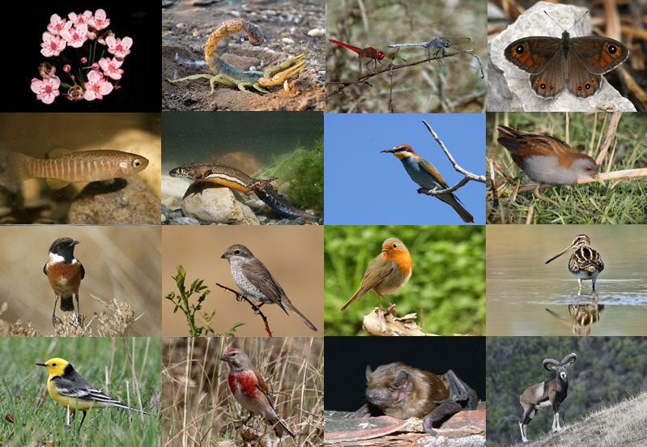
Species richness: Patterns

Slide 2
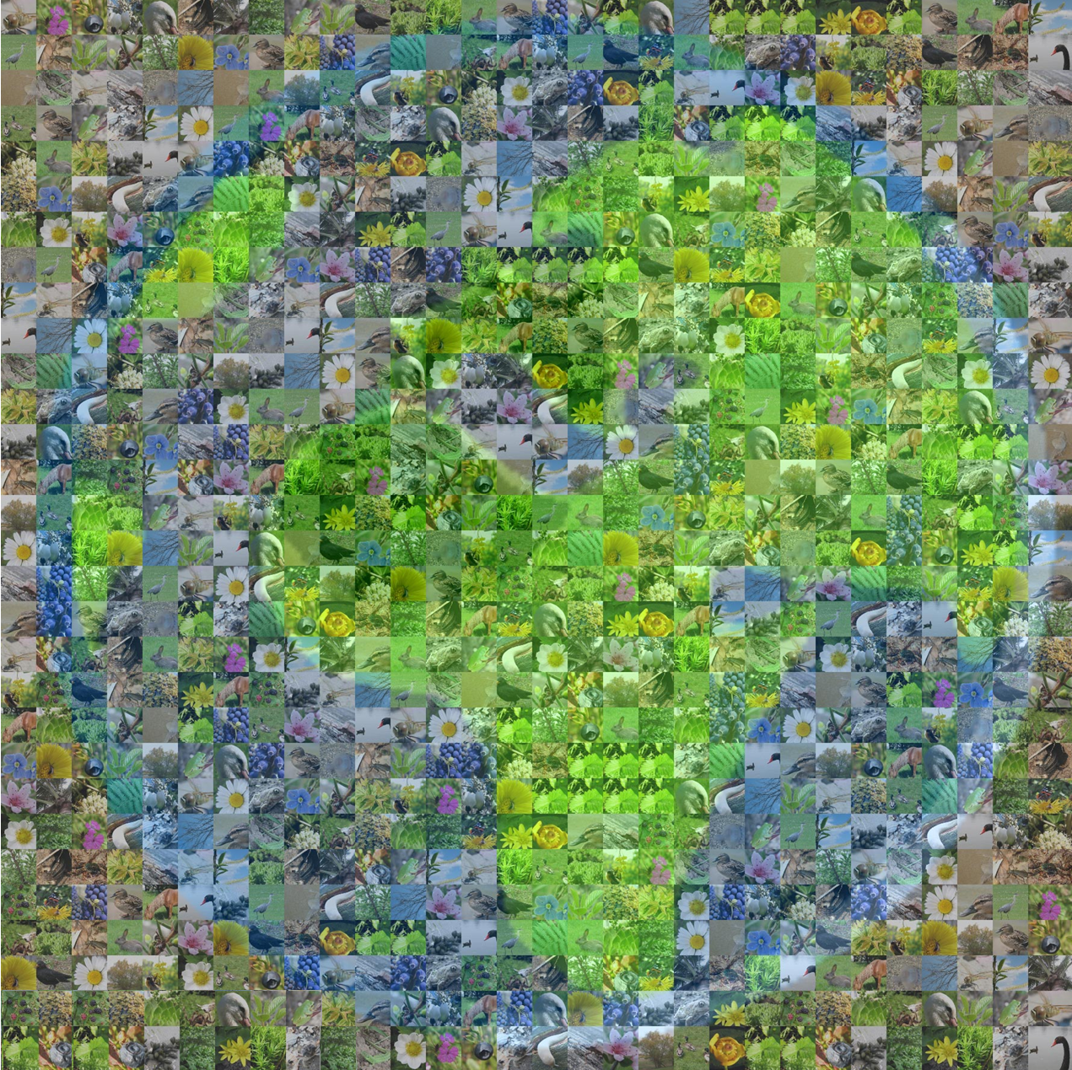
Two key questions about species richness:
1) How many species are there?
2) Where are they and why?

Slide 3
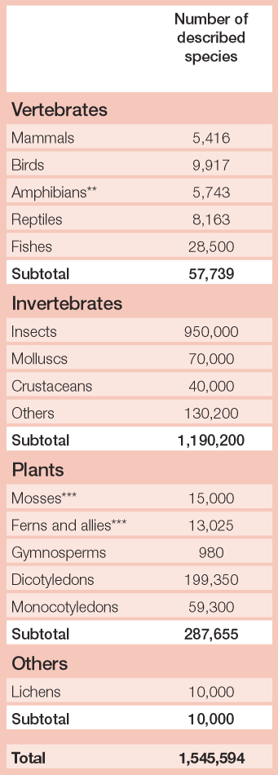
Baillie et al 2004, 2004 IUCN report

Slide 4
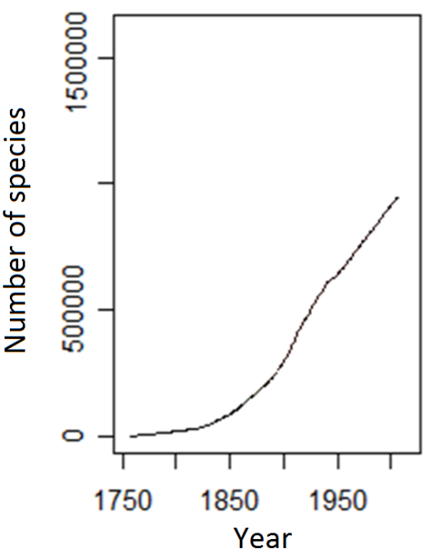
But how many species are there?:
Direct count
Directly we do not even know how many species have been described
Mora et al., Plos Biology 2011

Slide 5
But how many species are there?:
Indirect count
Biodiversity patterns approach
Raven (Bull. Entomol. Am. 1983) between 3 and 5 million species
About 1.5 million species have been described
2/3 occur in temperate regions
The ratio of temperate to tropical regions is about 1 to 2
Does not include bacteria and other micros
3 to 4.5 million species

Slide 6
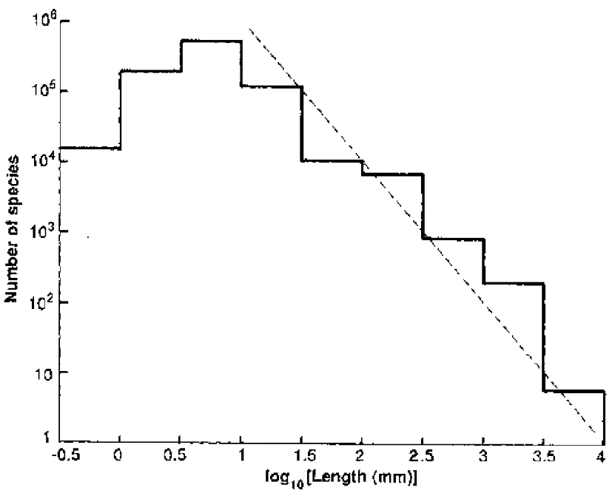
But how many species are there?:
Indirect count
Biodiversity patterns approach
May (Nature 1988) between 10 and 50 million species
Uncertainty on the number of small species

Slide 7
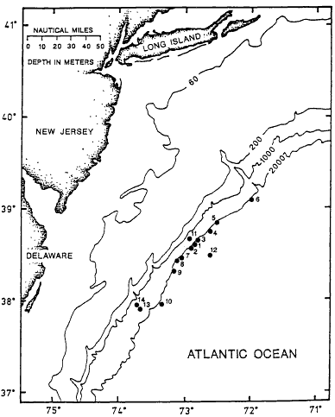
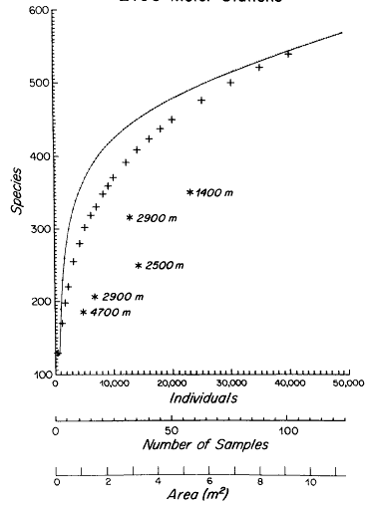
But how many species are there?:
Indirect count
Species-area relationships
Grassle & Maciolek (Amer. Nat. 1992) 10 million species; although only ~300.000 have been described
But to be conservative they suggested about 10 million
Extrapolated to the world’s deep sea floor area=100 million

Slide 8
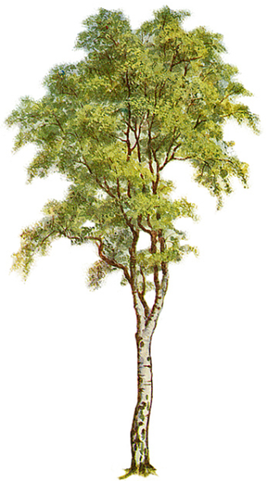
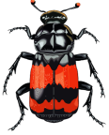
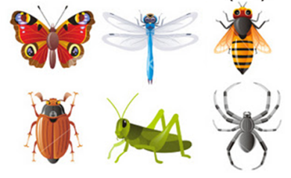

But how many species are there?:
Indirect count
Biodiversity ratios: Erwin(Bull Ent Soc Am 1983)
160 specialized beetle species on the canopy per tree species
4 out of 10 insect species are beetles
400 species specialized per tree’s canopies
2 out of 3 insect species live in the canopy, then
600 species specialized per tree species
Considering that there are 50.000 species of tropical trees, then there will be 30 million species of insects in the tropics

Slide 9

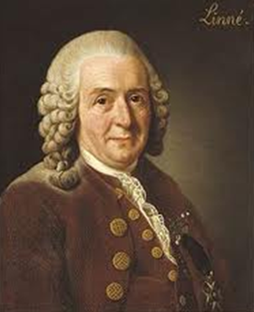

But how many species are there?:
Indirect count
Expert opinions
Ed Wilson
Carl Linnaeus
Among experts their opinions on the global number of species ranges between 3 and 100 million species (May 2010)
How many species are there?
Robert May
Unfortunately:
→ Expert opinions are variable. Lambshead (1993) 100 million species of nematodes. Lambshead and Boucher (2003) no more than 1 million.

Slide 10
How many species are there? Sources of information
Indirect calculation
Case study |  |  | Limitations
Macroecological patterns
 | Body size frequency distributions. By extrapolation from the frequency of large to small species, May (7) estimated 10 to 50 million species of animals. |  | May himself (7) suggested that there was no reason to expect a simple scaling law from large to small species. Further studies confirmed different modes of evolution among small species (4) and inconsistent body frequency distributions among taxa (4).
 | Latitudinal gradients in species. By extrapolation from temperate to tropical regions, Raven (10) estimated 3 to 5 million species of large organisms. |  | May (2) questioned the assumption that temperate regions were better sampled than tropical ones; the approach also assumed consistent diversity gradients across taxa which is not always true (4).
 | Species-area relationships. By extrapolation from the number of species in deep-sea samples, Grassle & Maciolek (13) estimated that the world’s deep seafloor could contain up 10 million species. |  | Lambshead & Boucher (12) questioned this estimation by showing that high local diversity in the deep sea does not reflect high global biodiversity given low species turnover.
 | Time-accumulation curves. By extrapolation from the discovery record it was estimated that there are ~19,800 species of marine fishes (22) and ~11,997 birds (21). |  | This approach is not widely applicable because it requires species accumulation curves to approach asymptotic levels, which is not common for most taxa (21-22).
Diversity ratios
 | Ratios between taxa. By assuming a global ratio of fungi to vascular plants of 6:1 and considering that there are ~270.000 species of vascular plants, HIndwksworth (20) estimated 1.6 million species of fungi. |  | Ratio-based approaches have been heavily critiqued because, given known patterns of species turnover, locally estimated ratios between taxa may or may not hold consistent at the global scale (3) and because at least one group of organisms should be well known at the global scale, which may not always be true (15). Bouchet (6) elegantly demonstrated the shortcomings of ratio-based approaches by showing how in a well-inventoried area the ratio of fishes to total multicellular organisms would yield ~0.5 million global marine species whereas the ratio of Brachyura to total multicellular organisms in the same sample would yield ~1.5 million species.
 | Host-specificity and spatial ratios. Given the 50.000 known species of tropical trees and assuming i) a 5:1 ratio of host beetles to trees, ii) that beetles represent 40% of the canopy arthropods and iii) that the canopy has twice the species of the ground, Erwin (9) estimated 30 million species of arthropods in the tropics.
 | Known to unknown ratios. Hodkinson & Casson (18) estimated that 62.5% of the bug species in a sampled location were unknown; by assuming that 7.5-10% of the global diversity of insects is bugs, they estimated between 1.84 and 2.57 million species of insects globally.
Expert opinions
 | Analysis of expert estimations. Estimates of ~5 million species of insects (15) and ~200,000 marine species (14) were arrived at by compiling opinion-based estimates from taxonomic experts. Robustness in the estimations is assumed from the consistency of responses among different experts. |  | Erwin (5) labeled this approach as "non-scientific” due to a lack of verification. Estimates can vary widely, even those of a single expert (5,6). Bouchet (6) argues that expert estimations are often passed on from one expert to another and therefore a "robust" estimation could be the same guess copied again and again.
Surprisingly, we do not really know how many species are there on Earth!
Mora et al. PlosBiology 2011
Notes:
22.14 min. one of the big non-nons about public presentation and I never do it…is to put many words on a slice, please never do that. But I deciced to do that because in this table it is summarized all we know about how many species are there on Earth. The most basic characteristic of our planet which is its diversity and we do not know how many species are there. And it is not that we have been slucking off, it just that it is truly a hard question to answer because there is not much data nor have we found reliable patterns that could allow us to get indirectly to this number.

Slide 11
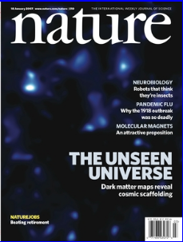
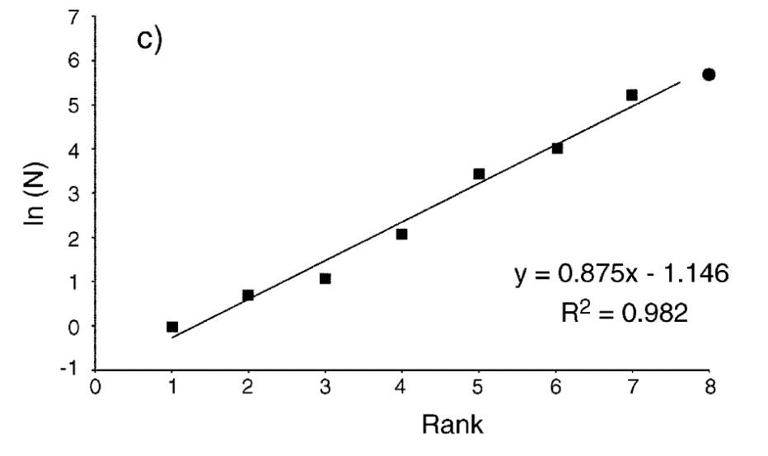
Nature, we think we can do it…
Response: ok, do it!
We tried everything:
Body size frequency distributions → To incomplete
Accumulation curves → To incomplete
Diversity rations → To variable
Nature, sorry, we could not do it.
…and just by accident…
Riccota et al 2002
Nature, we did it!
Response: sorry, now we do not want it anymore!
Notes:
And well one day a group of people driking bear said really what a serious problem that we do not know how many species are there. So lets write to Nature. And dump we wrote a very nice letter, with a lot of big guns as coauthors saying that we will have an anwser before a year. Nature we can, and bump we sent it to Nature. And Nature responded yea go ahead boys. Well and after that motivation of having a paper in Nature who does not work. An after a year of working and collecting of sorts of data none of those method resulted with a caliber to came out with a reliable number. We fail and had to write to Nature again, saying you know we are really sorry but we could not do it. And one day, on those things that happen by accident, I was working on a project on the deepsea and for not let in them down I started to work on deep sea diversity and then I came across this paper by Ricotta. I mean this paper is three papges long, it has been cited three times by the same first author so that article just none could find it. This person relates the number of taxa againts the taxonomic rank and then predict the number of species. And because I already have the data of all known species on Earth I decided to run this analysis. And you can imagine my excitement when this thing was giving a number. So we all that excitement we wrote back to Nature saying Nature we did it and they responded saying sorry we do not want it anymore. And well that was the story with Nature there.

Slide 12
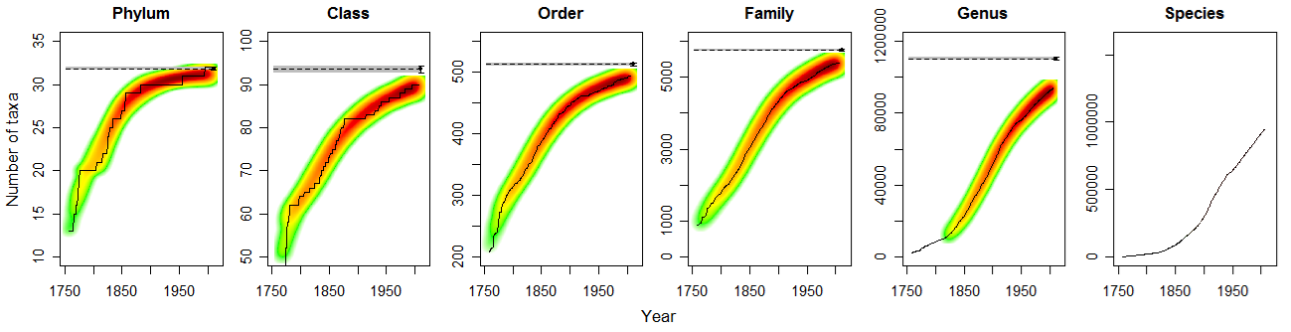
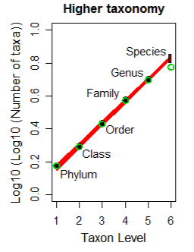
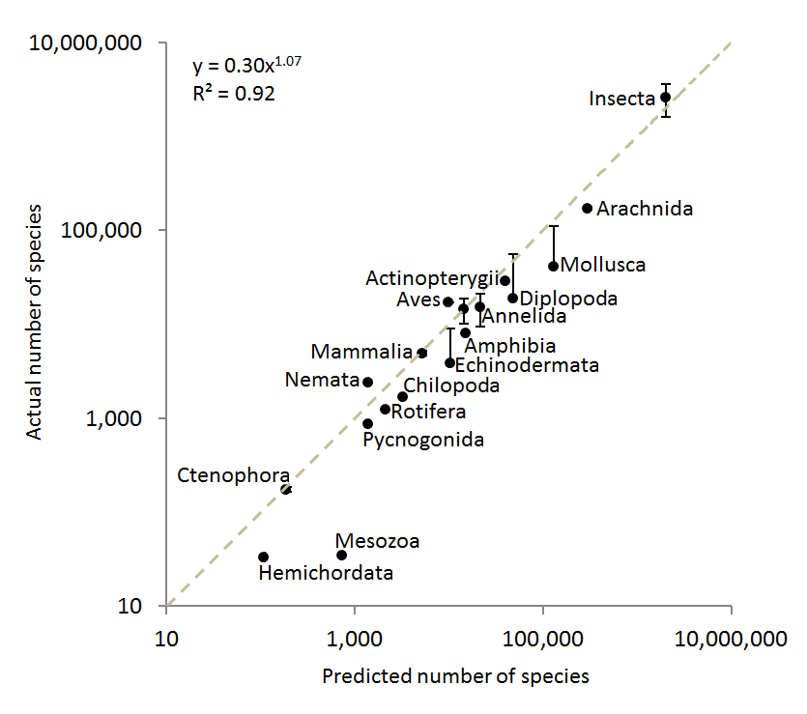
But how many species are there?:
Indirect count
Higher taxonomy
Mora et al. PlosBiology 2011

Slide 13
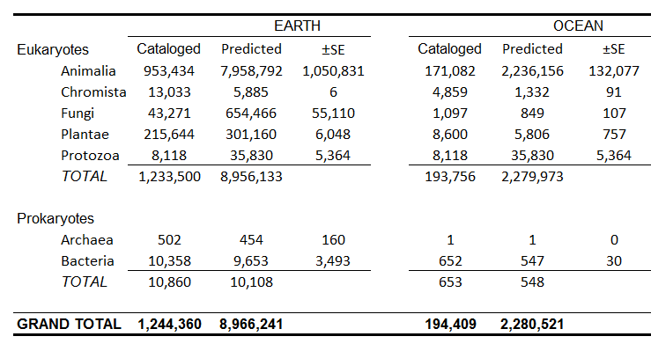
So how many species are there on Earth?
Implications
In average, 6,200 species have been described per year in the last 20 year…
so describing the remaining species could take up to 1,200 years
The average cost of describing an species is estimated at US$48,000…
so describing the remaining species could cost up to US$ 364 billions
In average a taxonomist describes 24.8 species in his/her life…
so describing the remaining species would require 303,000 taxonomists
Mora et al. PlosBiology 2011
Notes:
It is clear that filling this gap will not be easy

Slide 14
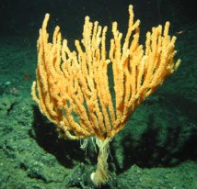
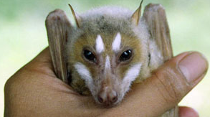
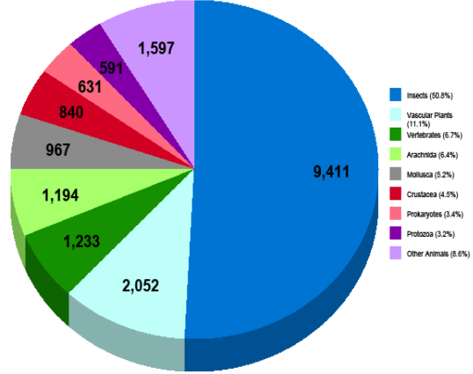
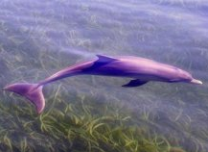
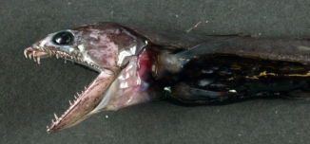
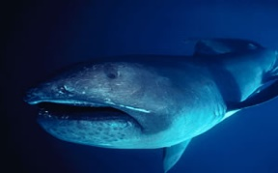
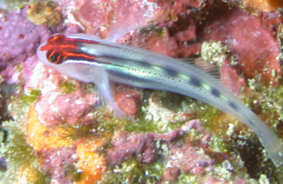
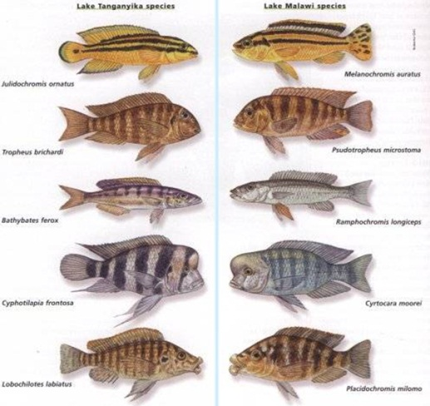
So how many species are there?
Answer: Nobody knows with certainty yet; but,
1) new species just keep poring in.
~17.000 new species were discovered in 2006 alone
Marine Terrestrial
Other animals
Protozoa
Prokaryotes
Crustacea
Pretty Ugly
Mollusca
Insects
Arachnida
Vertebrates
Large Small
Plants
SOS (State of Observed species 2007)
2) Many species are hard to differentiate and similar looking things may turn up to be different species.
So, perhaps we will never know…

Slide 15
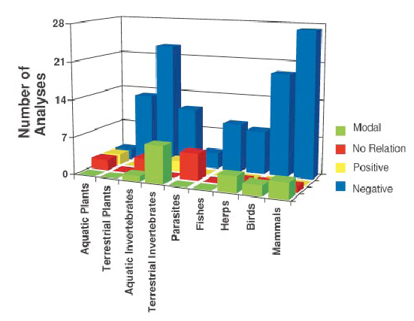
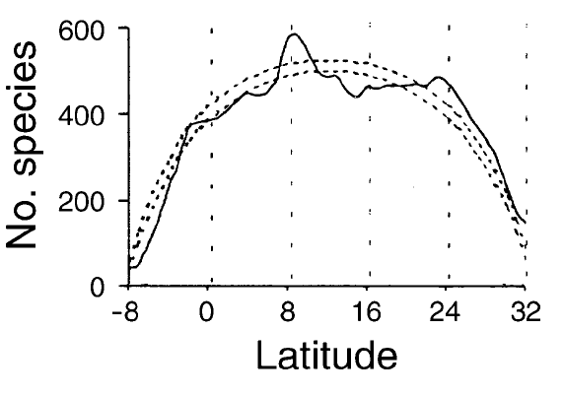
Where is biodiversity: THE PATTERNS
In general, it seems species are found on the tropics more so than in other places
Fishes
…but…there are problems…
Mora & Robertson (Ecology 2005)
Willig et al (Annu. Rev. Ecol. Syst. 2003)

Slide 16
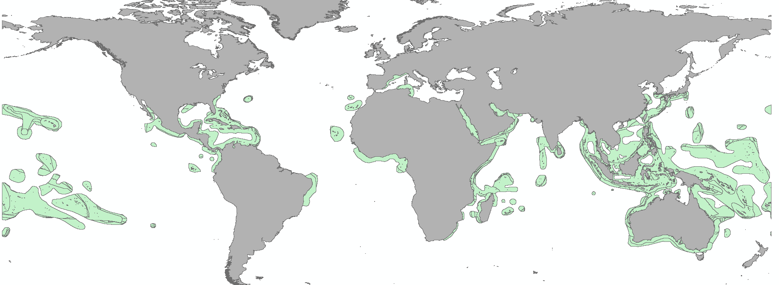
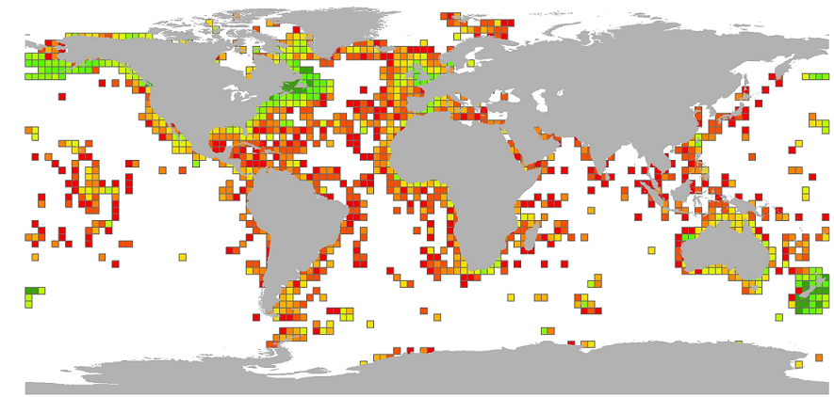
Where are the species?
How are species counted?:
Overlap of species ranges
Species census
Notes:
12 minutes

Slide 17
Where are the species?:
Ranges marine fishes in the Eastern Pacific
PROBLEMS: Range size effect
Temperate Tropics Temperate
Pattern marine fish richness in the Eastern Pacific
All 736 species
30º to 40º
20º to 30º
Number of species
10º to 20º
Up to 10º
Latitude
Latitude
Patterns based on all species underestimate the richness of species with small ranges
Mora & Robertson, Ecology 2005

Slide 18
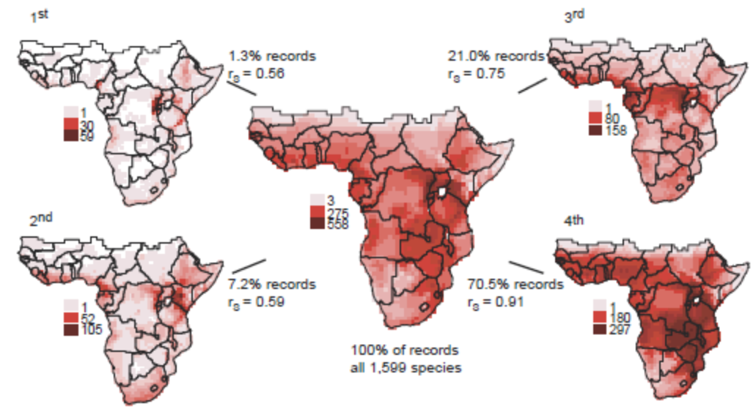
Where are the species?: Range size effect
Pattern of bird richness in Africa
Patterns based on all species underestimated the richness of species with small ranges
Jetz & Rabek, Science 2002

Slide 19
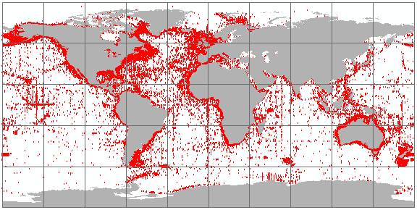
Where are the species?: Census data limitations
Occurrences of the marine fishes of the world
www.iobis.org
Sps expected
Number of species
Number of species
Sps observed
Sps observed
*100 = Percent completeness
Sps expected
Time (years)
Time (years)
Mora et al 2008, Proceedings Royal Society

Slide 20
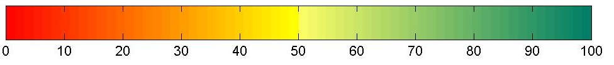
Completeness of the global census of marine fishes
Scale: 3º by 3º
Percent completeness
At a 3 by 3 degree resolution (approx. 350 km²), less than 1.8% of the world's oceans have above 80% of their fish fauna currently described.
Mora et al 2008, Proceedings Royal Society

Slide 21
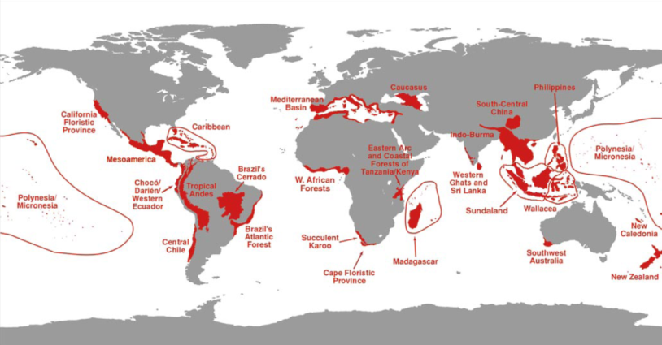
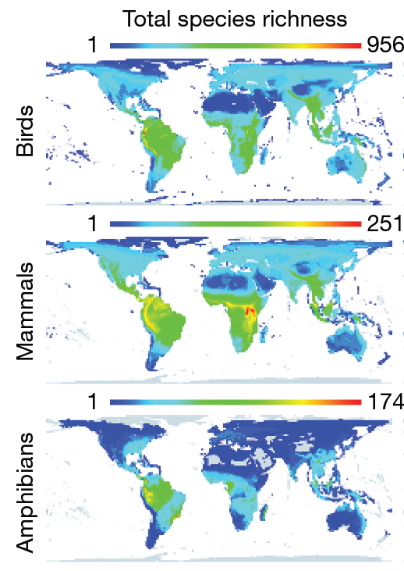
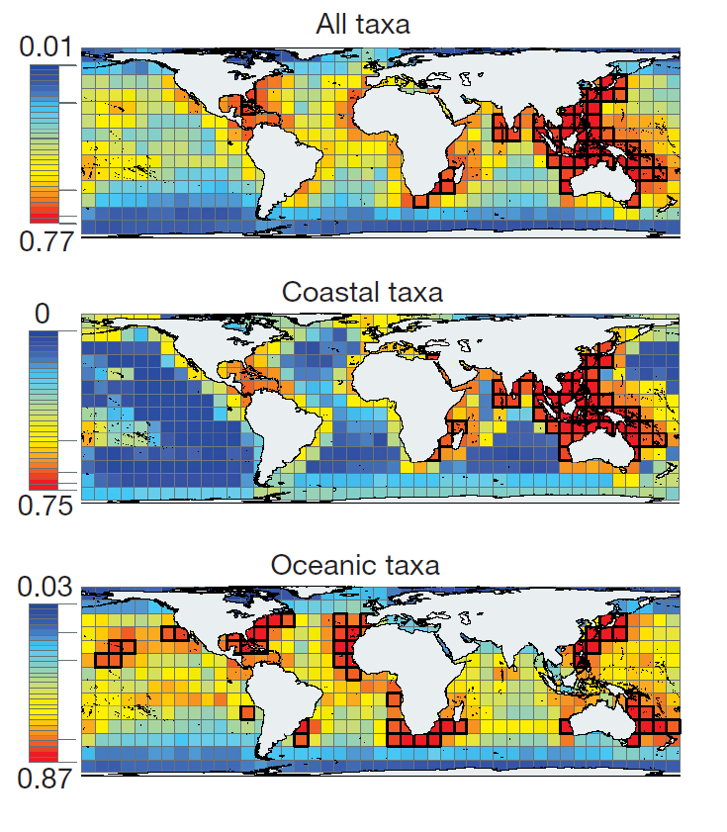
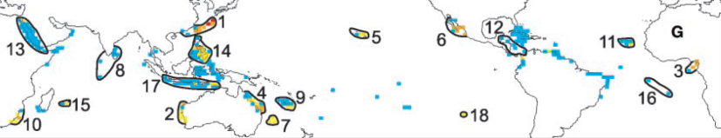
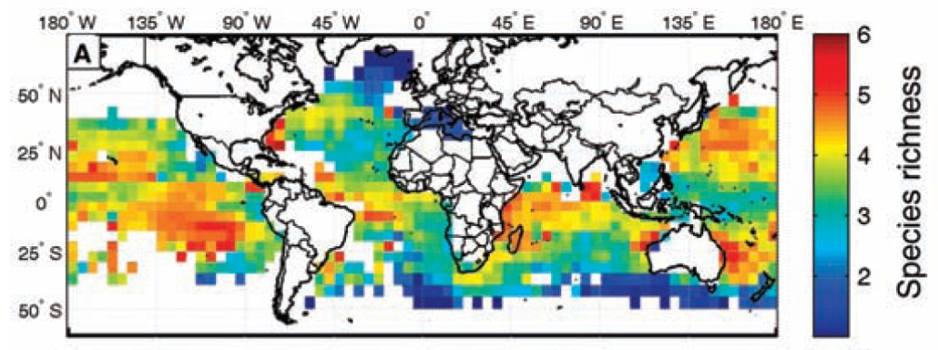
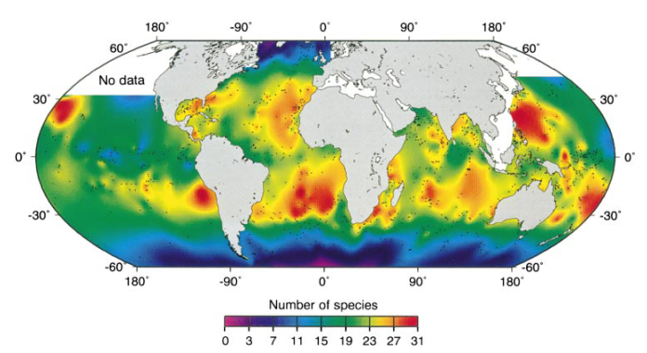
Where is biodiversity: PROBLEMS: Data comprehensiveness
About 10.000 species of vertebrates
About 20.000 species of vertebrates
About 13.000 species of Eukaryotes
Myers et al, Nature 2000
SO WHERE ARE THE REMAINING 8 MILLION SPECIES WE THINK EXISTS!
About 1.000 species of animals
Grenyer et al, Nature 2007
Roberts et al, Science 2002
Tittensor et al, Nature 2010
About 40 species of fish
About 30 species of foraminifera
Worms et al, Nature 2005
Ruthenford et al, Nature 1996
Notes:
We are now working on anwsering this question using novel statistics and comprihensive databases.

Slide 22
In summary
1.5 million described
We are not certain how many species are there in total; but
8.7 million best estimation
Data standardization
Overestimation of patterns with current data
We are also not certain of where are the species
We lack considerable data

